Slide 1
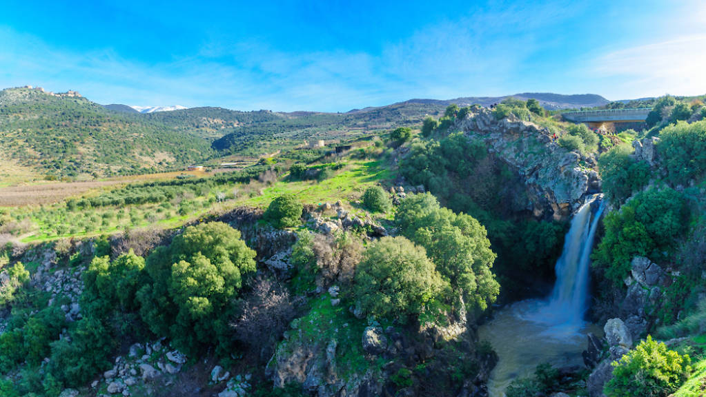

Do heat waves and air pollution events affects tourism in nature reserves in Israel?
In collaboration with the Nature and Parks Authority of Israel
Eliran Elizarov & Nitzan Gabay

Slide 2
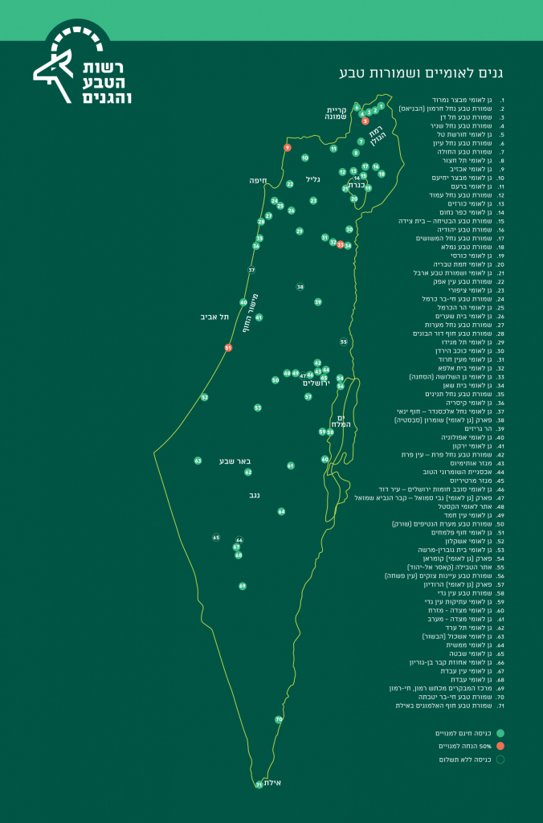
Nature and Parks Authority of Israel
The government authority in charge of preserving the values of nature and heritage in the country
Subject to the Ministry of Environmental Protection
Responsible for the management of nature reserves and national parks
Responsible for enforcing the nature conservation law in open areas

Slide 3
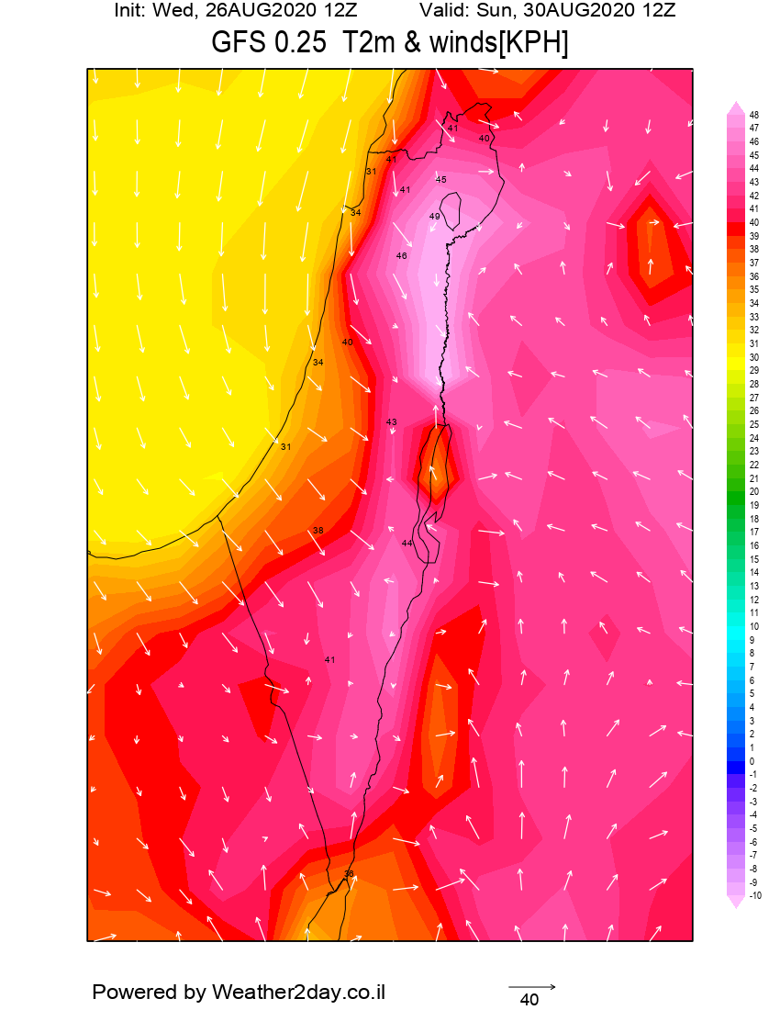
Heat Waves
In Israel, heat waves are accompanied by great dryness. The definition of heat wave is at least 30° Celsius

Slide 4
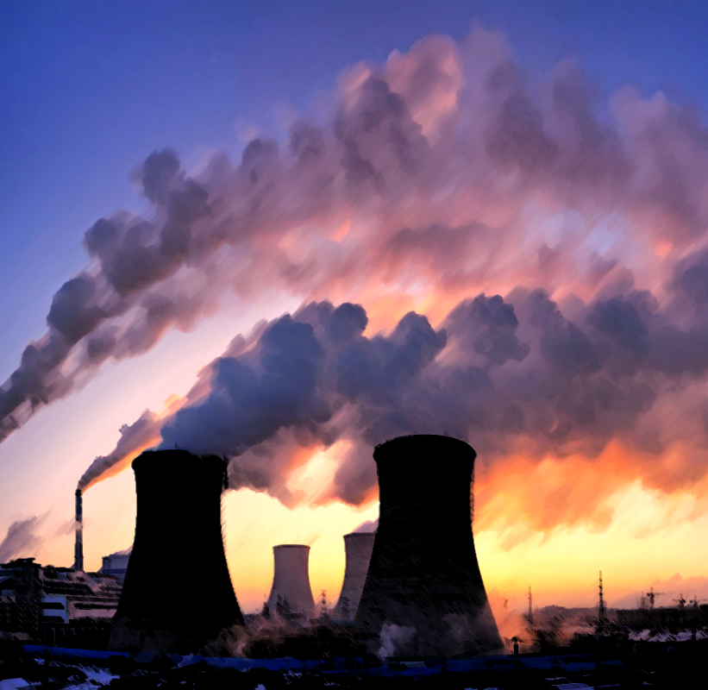
Air Pollution
Natural sources
Natural Fires
Volcanic activity
Dust from natural sources (Deserts)
Methane, emitted by the digestion of food by animals
Anthropogenic (human-made) sources
Industrial facilities and factories
Burning fuel at power plants
Waste incineration
Fuel and various means of transportation

Slide 5
Air Pollution
We focused on 4 different air pollution indices
All air pollution indices have their particle size, and the air is considered polluted if the number of particles is greater than the maximum set value
Max Value | Measure
130 | PM10
37.5 | PM2.5
200 | NO2
50 | SO2

Slide 6
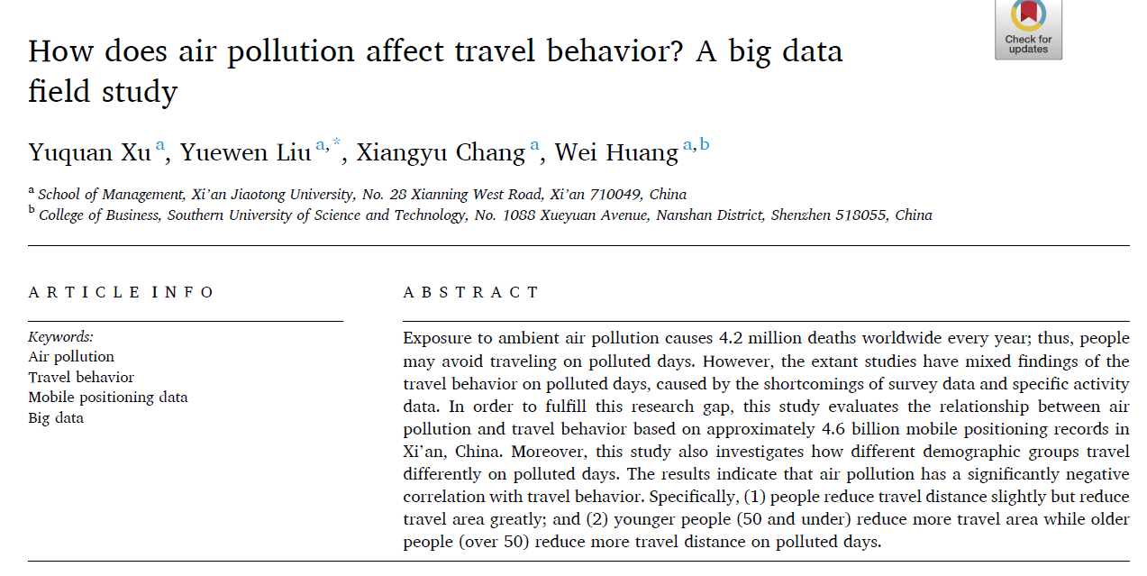
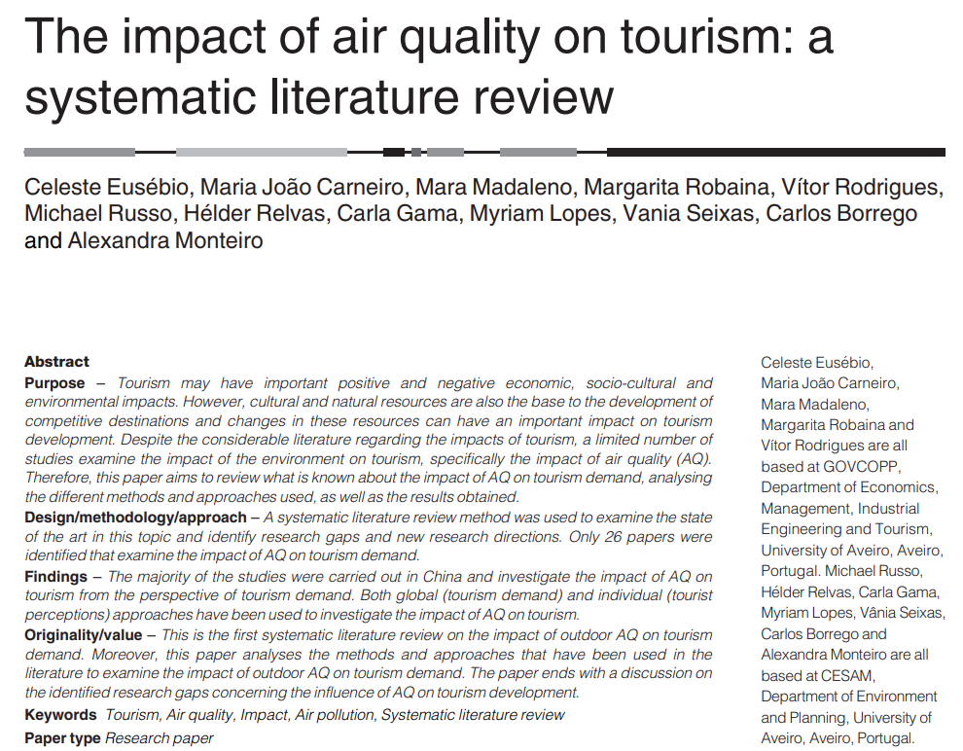
Literature Review

Slide 7
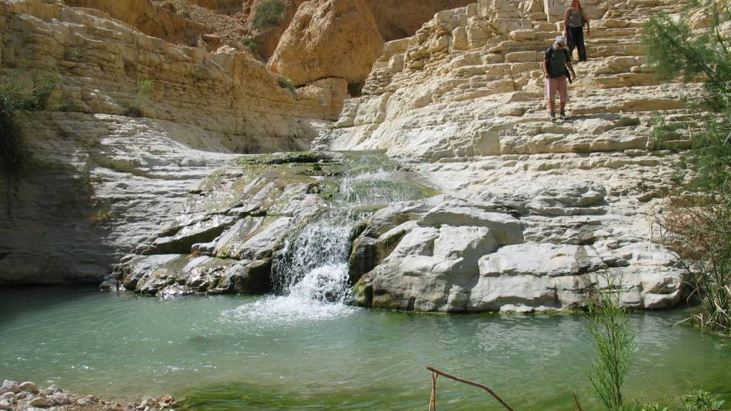
Research Questions
Do heat waves affect the number of hikers in nature reserves in Israel?
Do air pollution events affect the number of hikers in nature reserves in Israel?
Is there a difference in the above two questions between Israeli travelers and tourists?

Slide 8
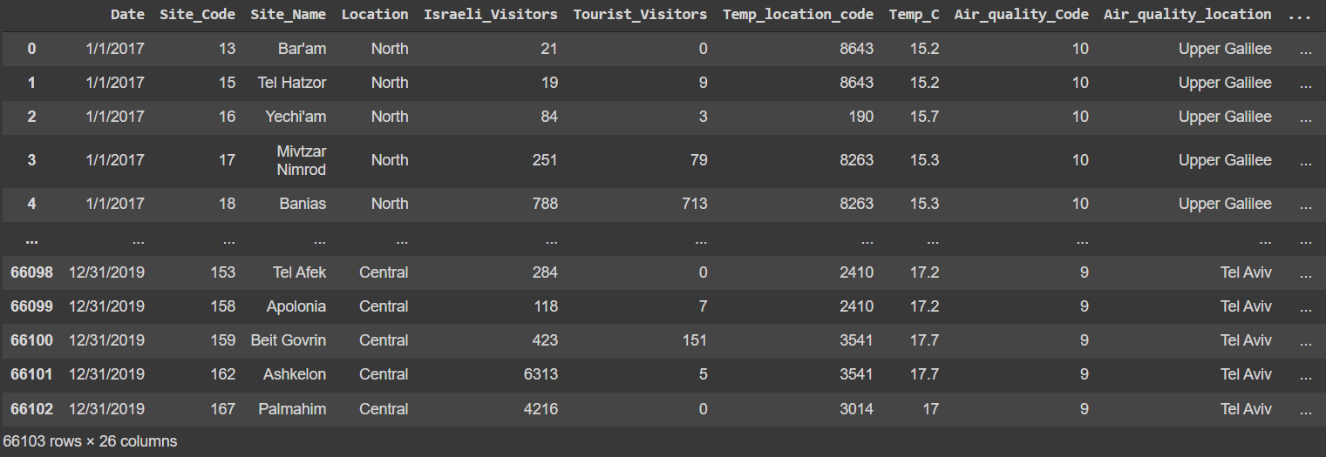
Our Data
We Had 67 different sites
We analyzed the data according to 21 different features
We segmented the data by Israeli visitors and tourists, by air pollution indices, by seasons

Slide 9
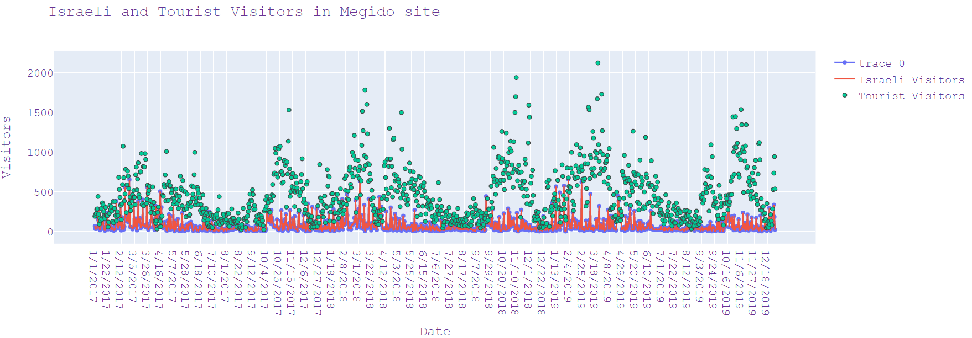
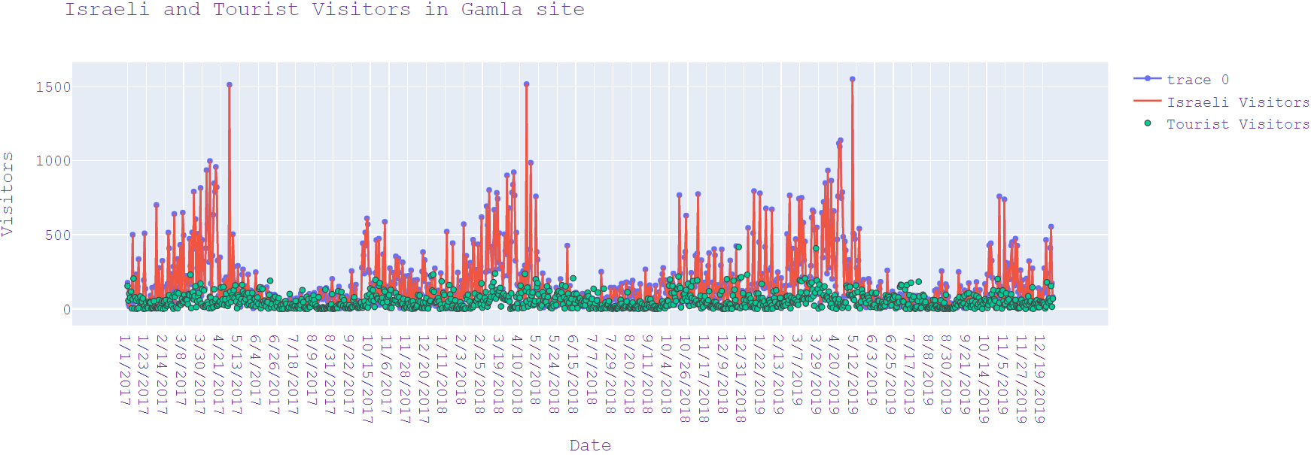
Some Statistics

Slide 10
T-tests
We performed 5 different t-test of 2 samples each (Israeli & tourists). One of them (No2) was irrelevant.
H0: Heat waves / Air Pollution events do not affect the number of visitors in nature reserves in Israel
H1: Heat waves / Air Pollution events affect the number of visitors in nature reserves in Israel
T-test 1 - PM10: High value of PM10 do not affect the number of visitors in nature reserves
T-test 2 - PM2.5: High value of PM2.5 affect the number of visitors in nature reserves
T-test 3 - So2: High value of So2 do not affect the number of visitors in nature reserves
T-test 4 - Heat: High temperature (heat wave) affect the number of visitors in nature reserves

Slide 11

Models
We chose a sample of 4 sites - Gamla, Megiddo, Banias and Metzada
The reason for our choice - diversity of geographic area, visitors amount and kind of site
We built 25 linear regression models

Slide 12
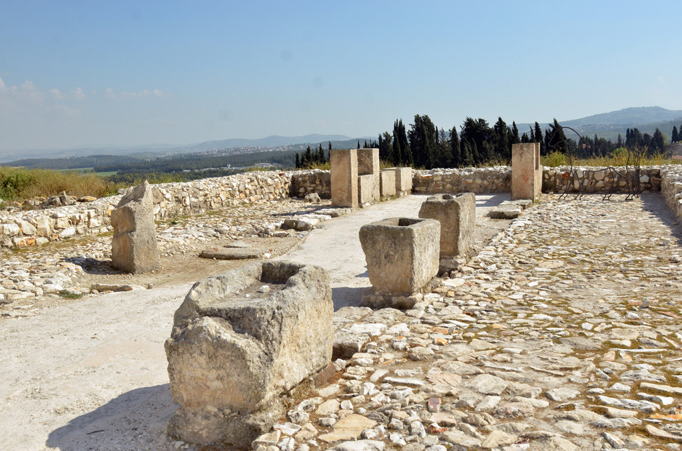

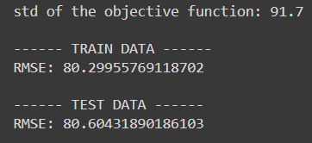
Tel Megiddo
Israeli visitors pm25

Slide 13

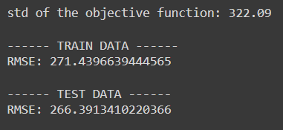
Tel Megiddo
Tourist visitors pm25

Slide 14
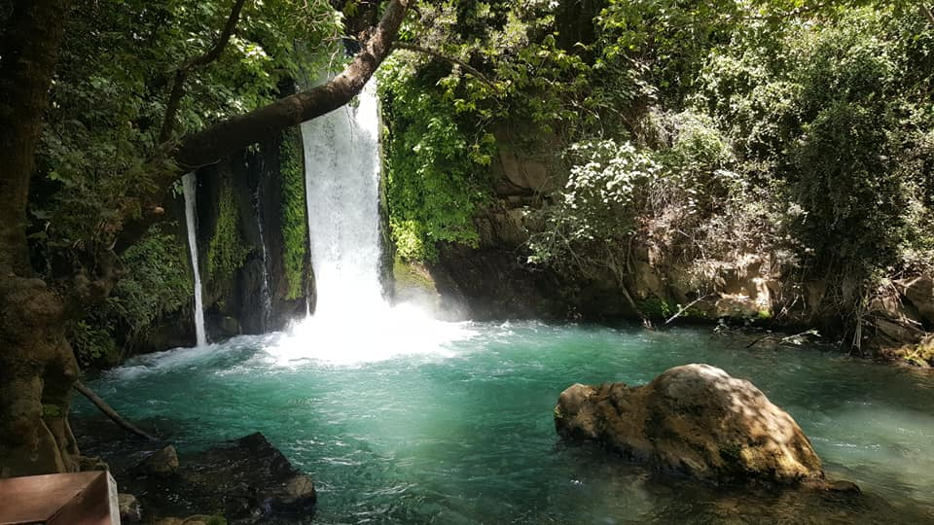

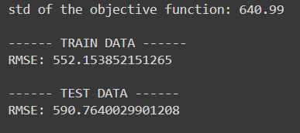
Banias
Israeli visitors no2

Slide 15

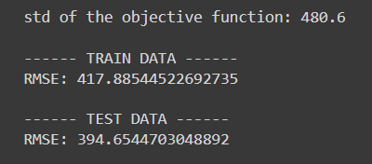
Banias
Tourist visitors no2

Slide 16
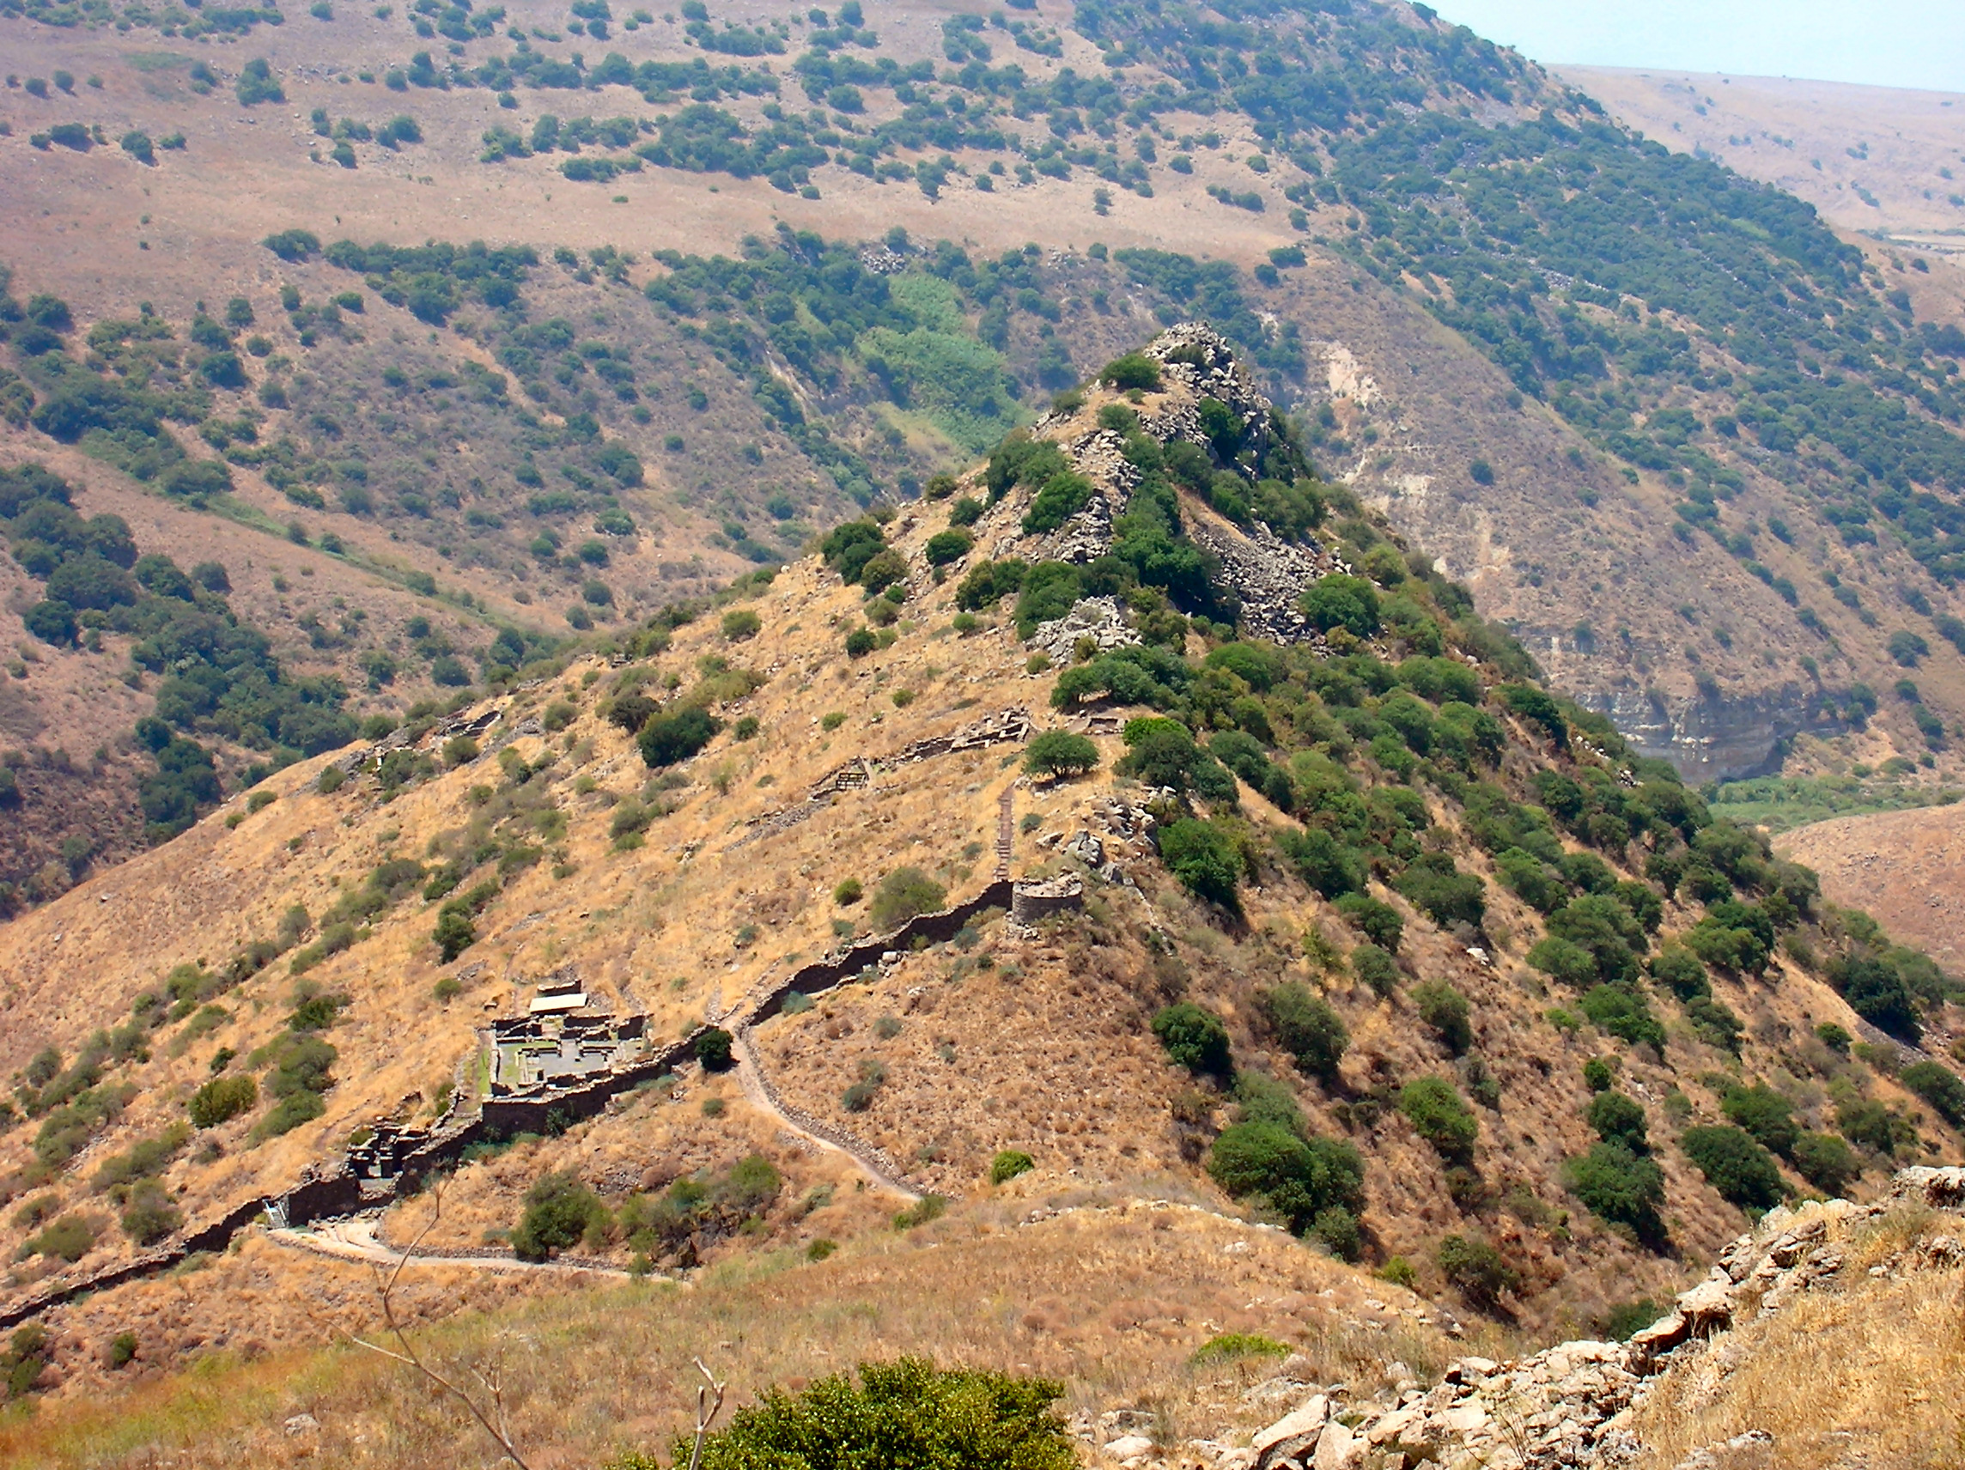

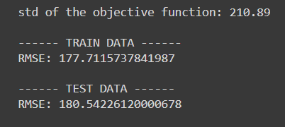
Gamla
Israeli visitors pm25

Slide 17

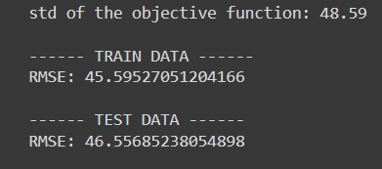
Gamla
Tourist visitors pm25

Slide 18
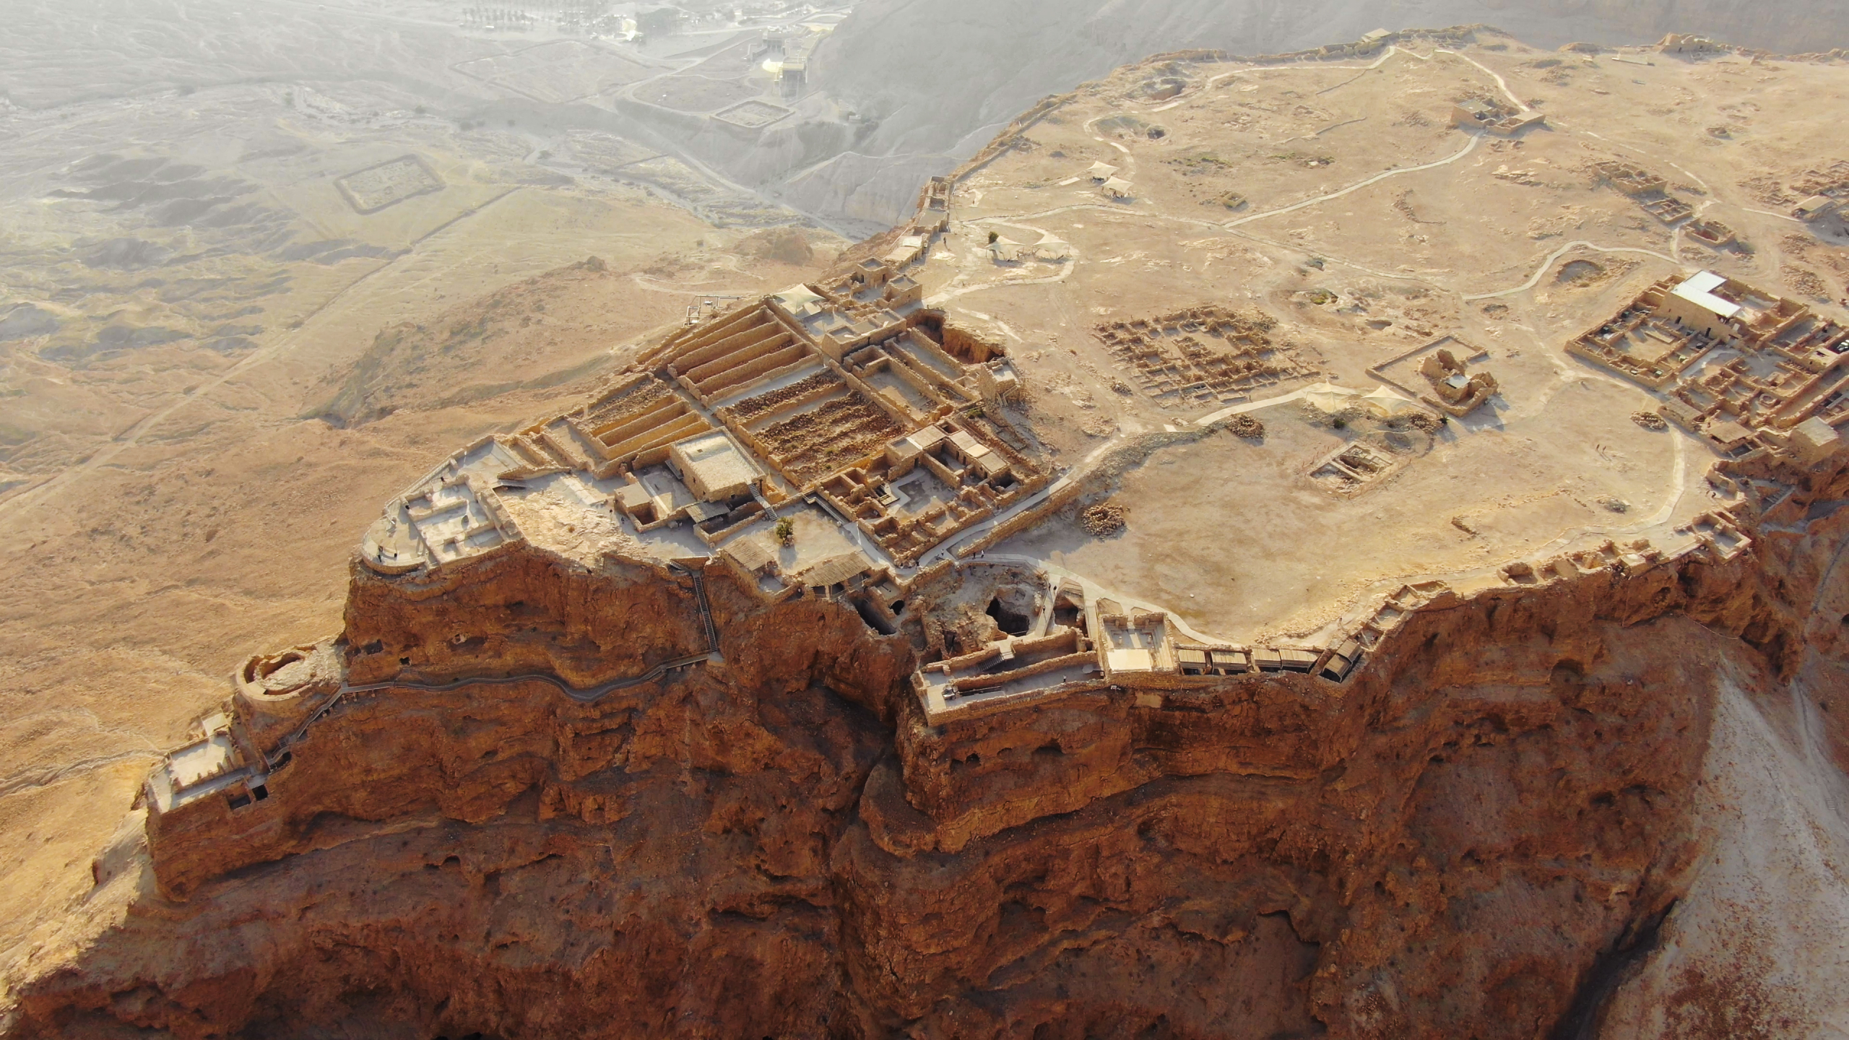

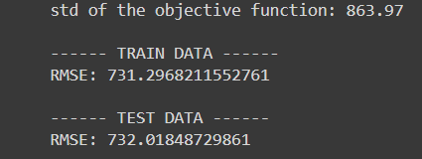
Metzada
Israeli visitors no2

Slide 19

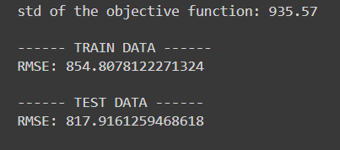
Metzada
Tourist visitors no2

Slide 20
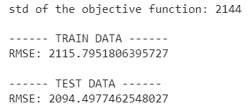
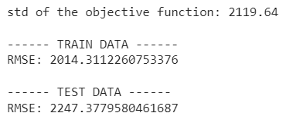

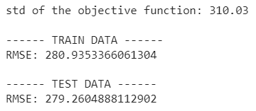
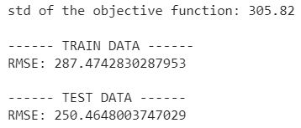
Summer Times
Israeli visitors, PM2.5
Israeli visitors, No2
Tourists, PM2.5
Tourists, No2

Slide 21

Conclusions
The models support the research questions
The models are good and faithfully reflect the prediction of visitors
There seems to be a direct correlation between the level of air pollution and temperature to the number of visitors, although some features had more influence (such us seasons and weekend)

Slide 22
Thank You !

